Slide 1

Python 101
Mico Siahaan

Slide 2


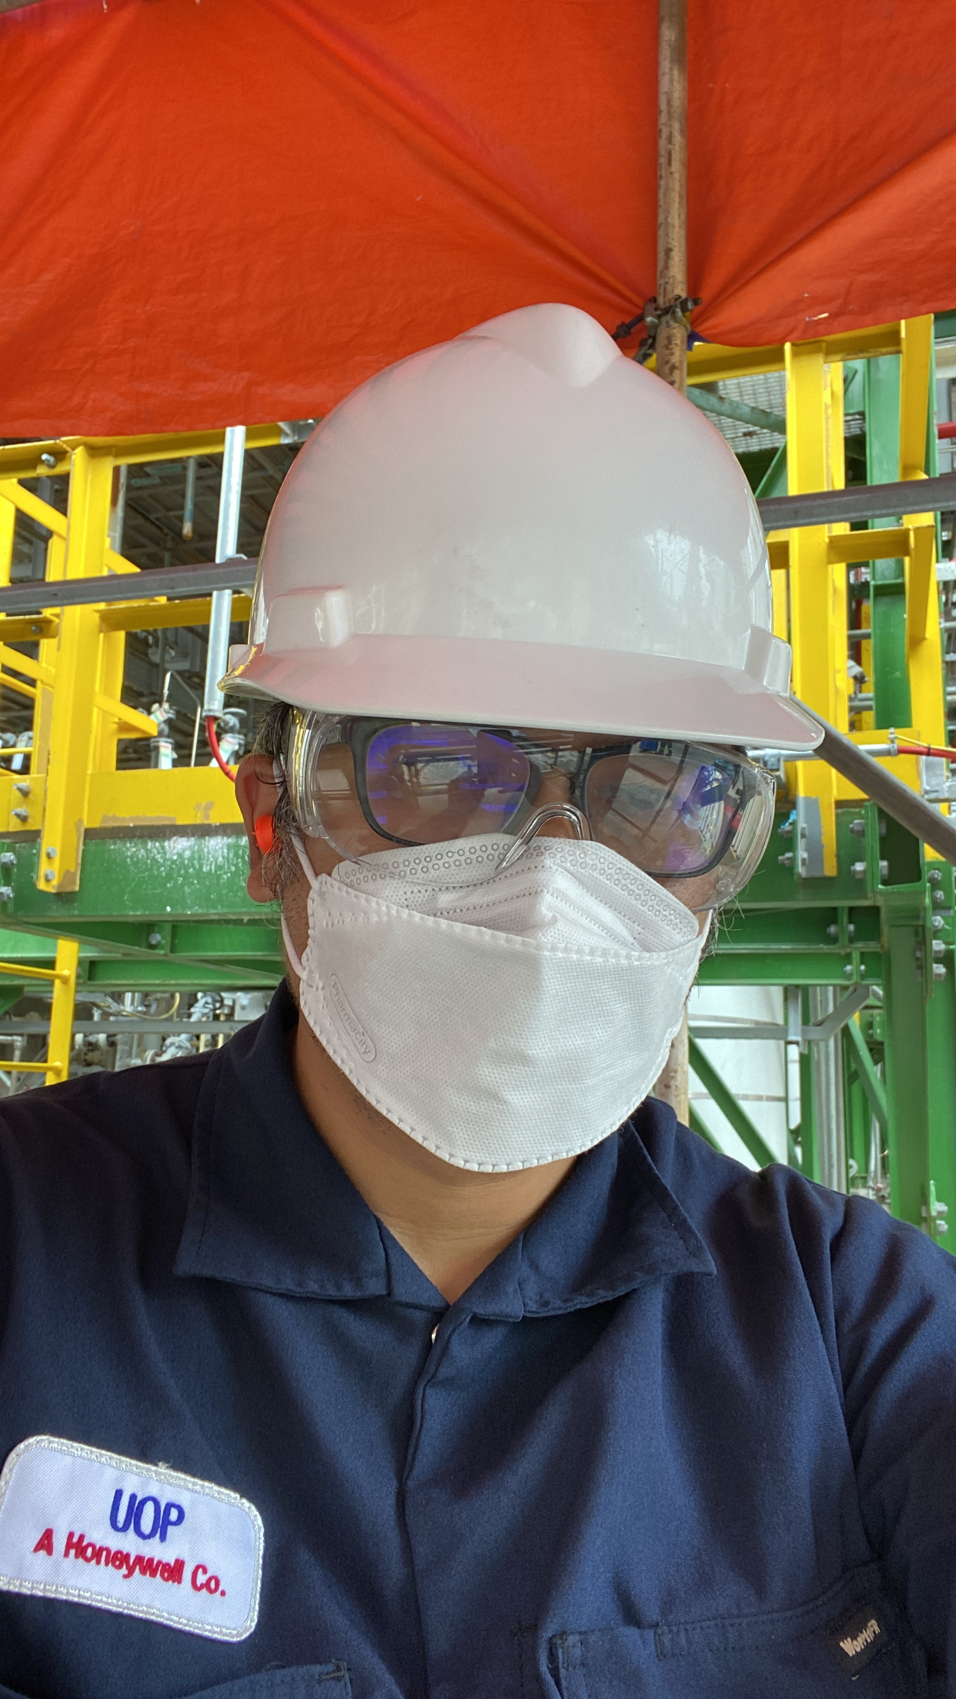
About Me
Pendidikan: Teknik Kimia
Mengenal Python: 2000
Salah satu admin Telegram Python Indonesia

Slide 3
Bahasa Pemrograman Python
Kepustakaan (library & modul) yang beragam dan (cukup) lengkap
Multiplatform
Mudah dipelajari
Sumber Terbuka (Open Source)

Slide 4
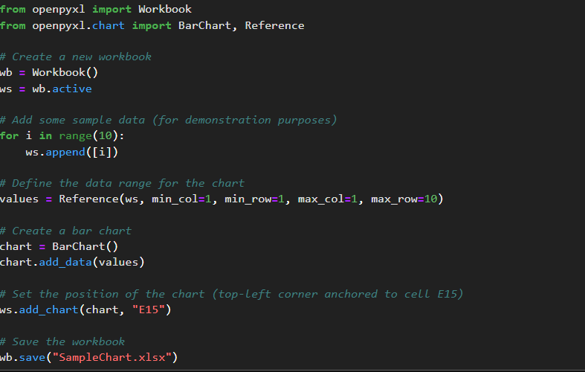
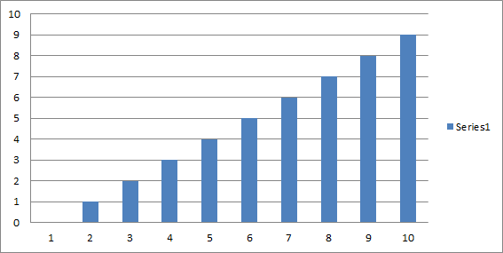
Python: openpyxl, otomasi Excel

Slide 5
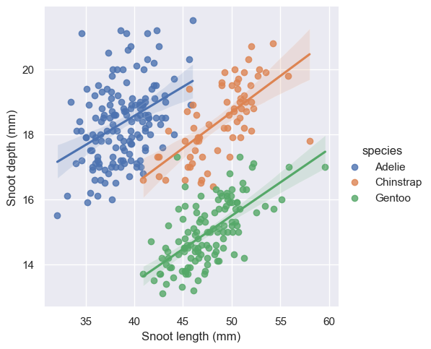
Python: Seaborn, visualisasi data
 | species | island | bill_length_mm | bill_depth_mm | flipper_length_mm | body_mass_g | sex
0 | Adelie | Torgersen | 39.1 | 18.7 | 181.0 | 3750.0 | Male
1 | Adelie | Torgersen | 39.5 | 17.4 | 186.0 | 3800.0 | Female
2 | Adelie | Torgersen | 40.3 | 18.0 | 195.0 | 3250.0 | Female
3 | Adelie | Torgersen | NaN | NaN | NaN | NaN | NaN
4 | Adelie | Torgersen | 36.7 | 19.3 | 193.0 | 3450.0 | Female
5 | Adelie | Torgersen | 39.3 | 20.6 | 190.0 | 3650.0 | Male
6 | Adelie | Torgersen | 38.9 | 17.8 | 181.0 | 3625.0 | Female
7 | Adelie | Torgersen | 39.2 | 19.6 | 195.0 | 4675.0 | Male
8 | Adelie | Torgersen | 34.1 | 18.1 | 193.0 | 3475.0 | NaN
9 | Adelie | Torgersen | 42.0 | 20.2 | 190.0 | 4250.0 | NaN

Slide 6

Python: Django web frameworks

Slide 7
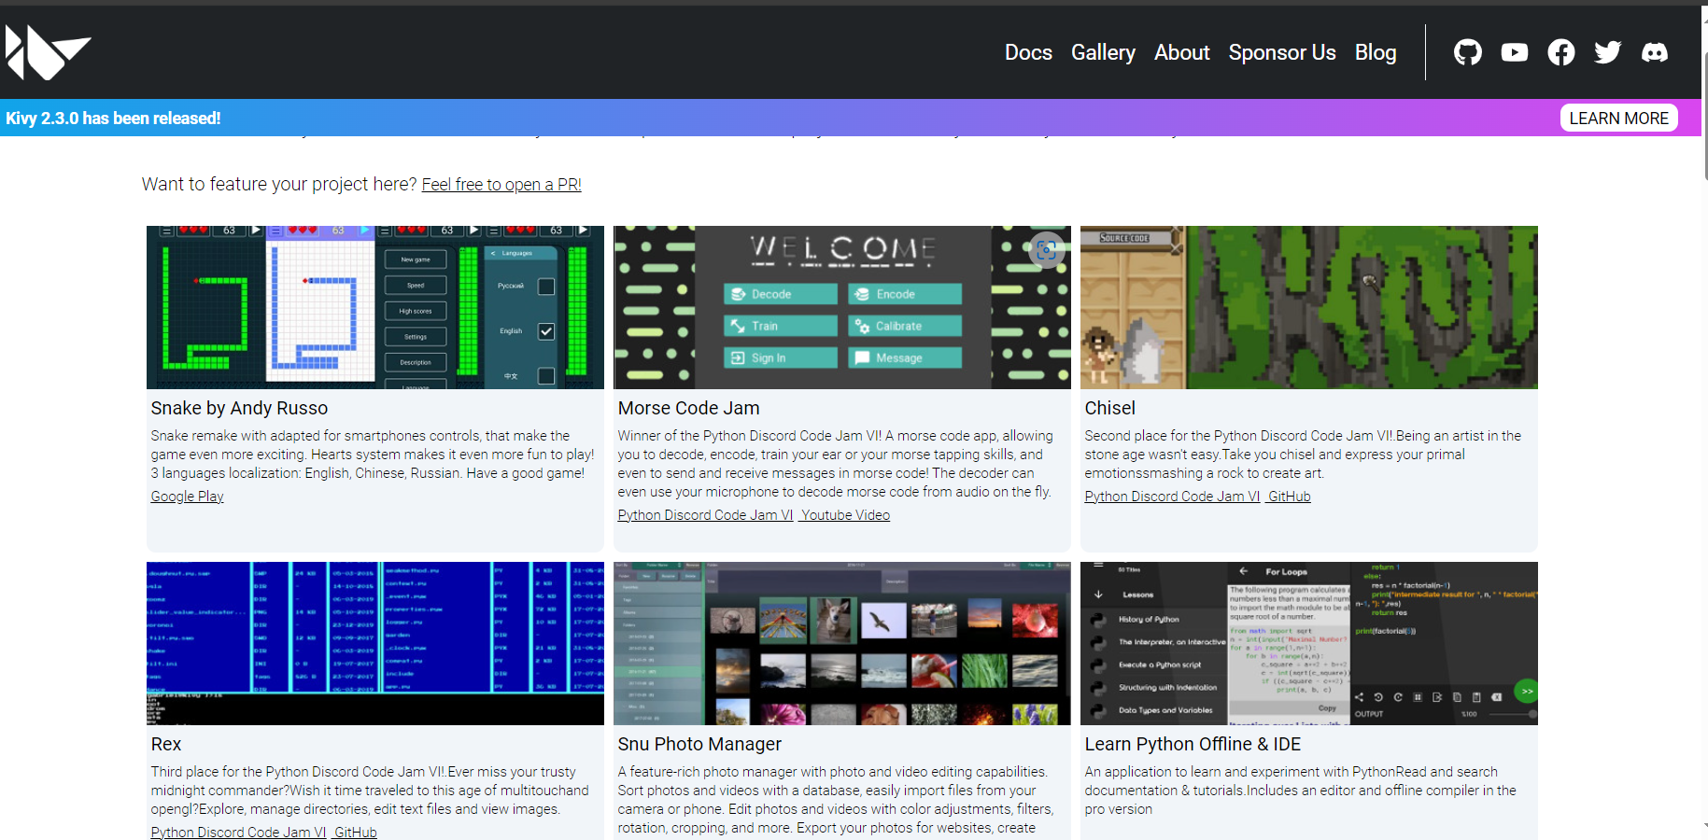
Python: Kivy, cross platform framework

Slide 8
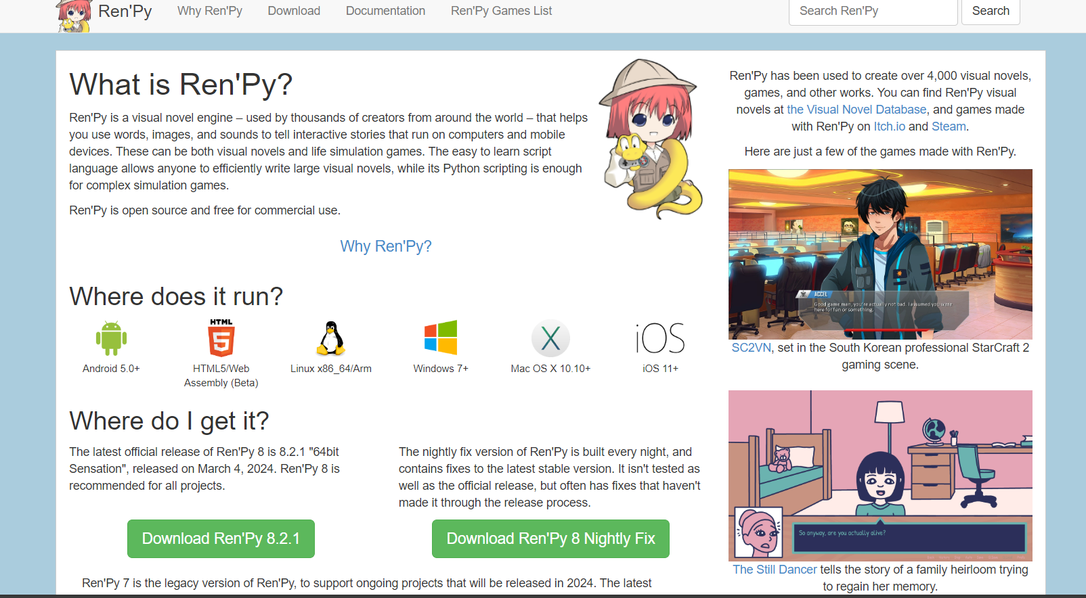
Python: Ren’Py, visual novel engine

Slide 9
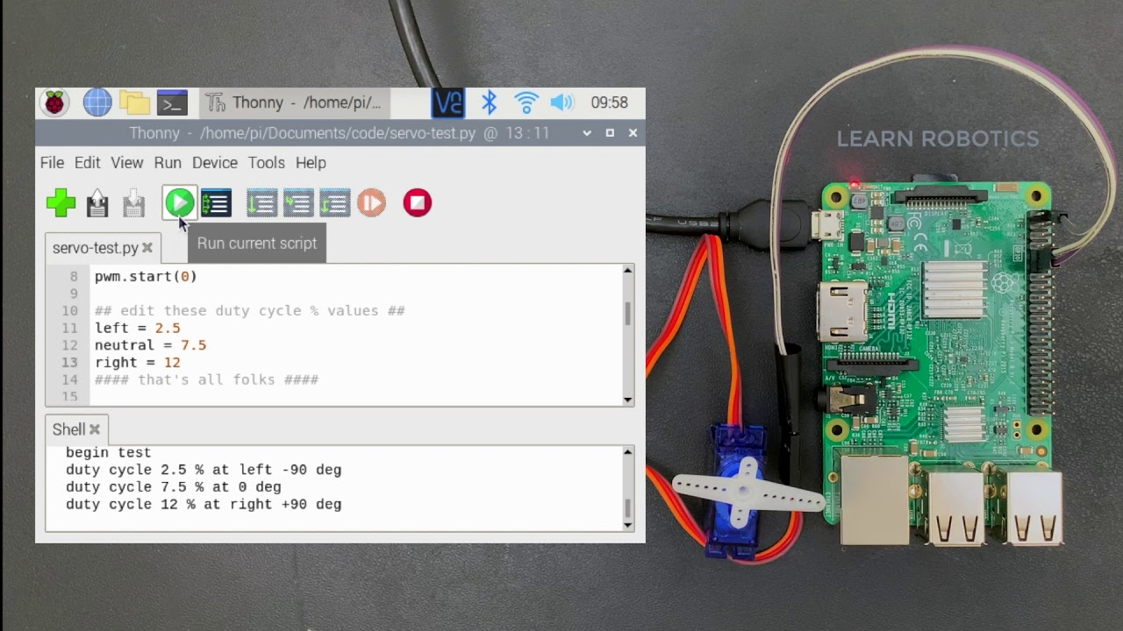
Python in Raspberry Pi

